Slide 1
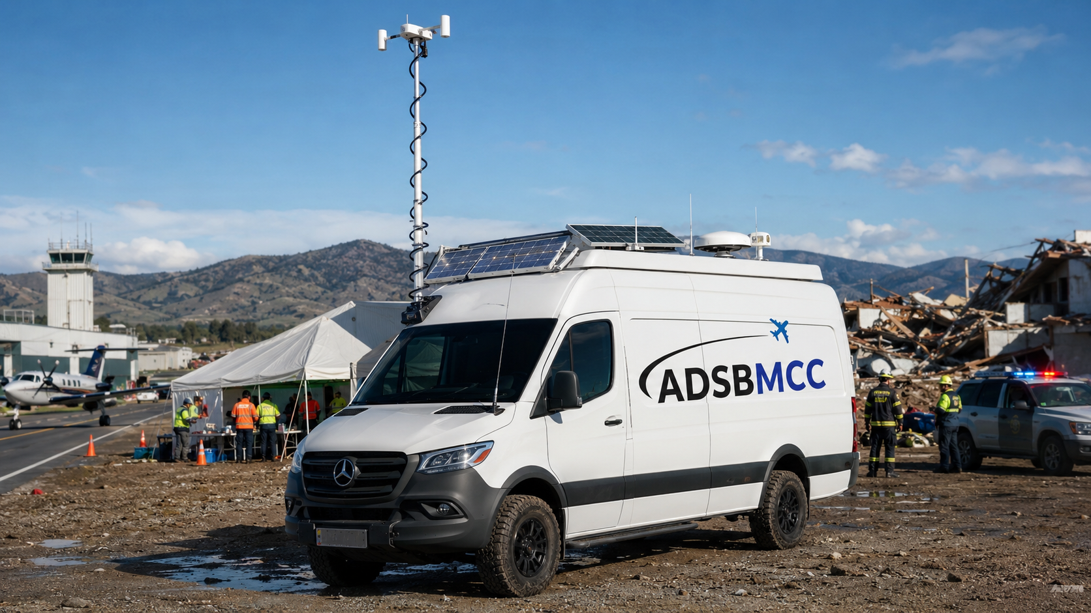
✈
ADSBMCC
ADS-B MOBILE COMMAND CENTER
ADSBMCC
ADS-B Mobile Command Center
Self-sustaining airspace surveillance for disaster response, remote operations, and temporary coverage pockets.
HYBRID POWER
RETRACTABLE MAST
ONE-PERSON KIT
Investor concept deck • adsbmcc.com

Slide 2
✈
ADSBMCC
The surveillance gap appears when infrastructure is stressed
ADS-B MOBILE COMMAND CENTER
Airspace awareness can degrade after hurricanes, wildfires, earthquakes, temporary airport outages, or remote field operations.
01
Line-of-sight problem
ADS-B and radar-like surveillance are constrained by terrain, obstruction, antenna height, and operational power/connectivity. A mobile tower changes the geometry quickly.
02
Temporary “coverage pocket”
A van or case can create a localized cone of reception around an incident command post, airport ramp, coastline, island, valley, or wildfire staging base.
Use case: mobile, provisional surveillance support — not a substitute for certified ATC separation service unless integrated, approved, and accepted by the responsible aviation authority.
03
Continuity & redundancy
<15 min
4+
1–4
Shore power, solar, battery, generator/hybrid fuel, cellular, satellite, and direct fiber/Ethernet support a layered field architecture.
Deployable coverage concept
Power modes
Operator options
adsbmcc.com
02

Slide 3
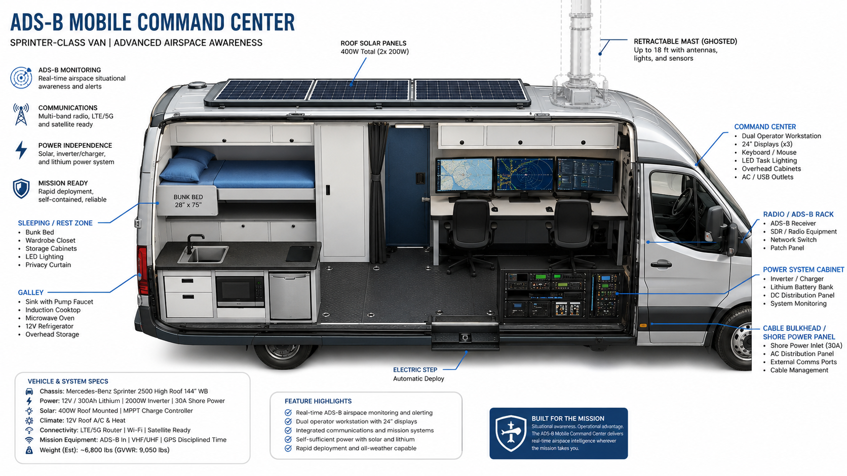
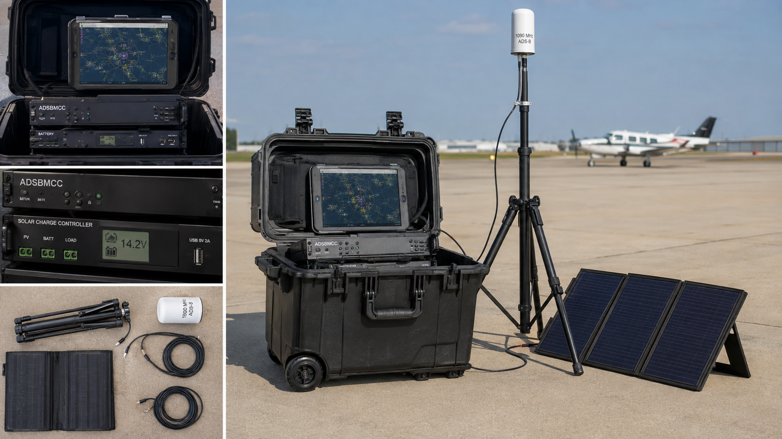
✈
ADSBMCC
The product: a van + portable case system
ADS-B MOBILE COMMAND CENTER
ADSBMCC packages certified-grade architecture, field power, and deployment workflows into two marketable configurations.
B
Pelican-case rapid kit
A
Van platform
One-person roll-in node with ADS-B receiver, embedded compute, lithium battery, tripod mast, foldable solar, cellular/satellite backhaul, and quick-connect building handoff.
Sprinter-class high-roof mobile command center with sleep/rest zone, command desk, radios, network rack, solar, battery, shore power, mast, and hardened cable bulkhead.
adsbmcc.com
03

Slide 4
✈
ADSBMCC
Reference architecture
ADS-B MOBILE COMMAND CENTER
A modular stack designed for standards alignment, rapid staging, and integration with incident command or airport operations.
RF Capture
1090ES / optional UAT
Receiver +
Timing Source
Track Processor
ASTERIX CAT021
Display + Alerts
Ops Console
Backhaul
LTE / Sat / Fiber
Client Feed
API / Ops Room
✓
Standards posture
🔒
Security posture
ED-129C defines minimum technical specification for 1090 MHz Extended Squitter ADS-B surveillance systems. Position the company as “ED-129C-aligned by design” until formal certification, acceptance testing, and authority approvals are complete.
Encrypt backhaul, log chain of custody, segment admin access, maintain tamper-evident kit seals, and generate deployment reports with health, uptime, GPS time quality, and data availability.
↔
Field integration
Offer RJ45/fiber handoff, PoE options, VPN endpoint, local display wall, downloadable aircraft movement archive, and direct cable from van to building command post.
adsbmcc.com
04

Slide 5
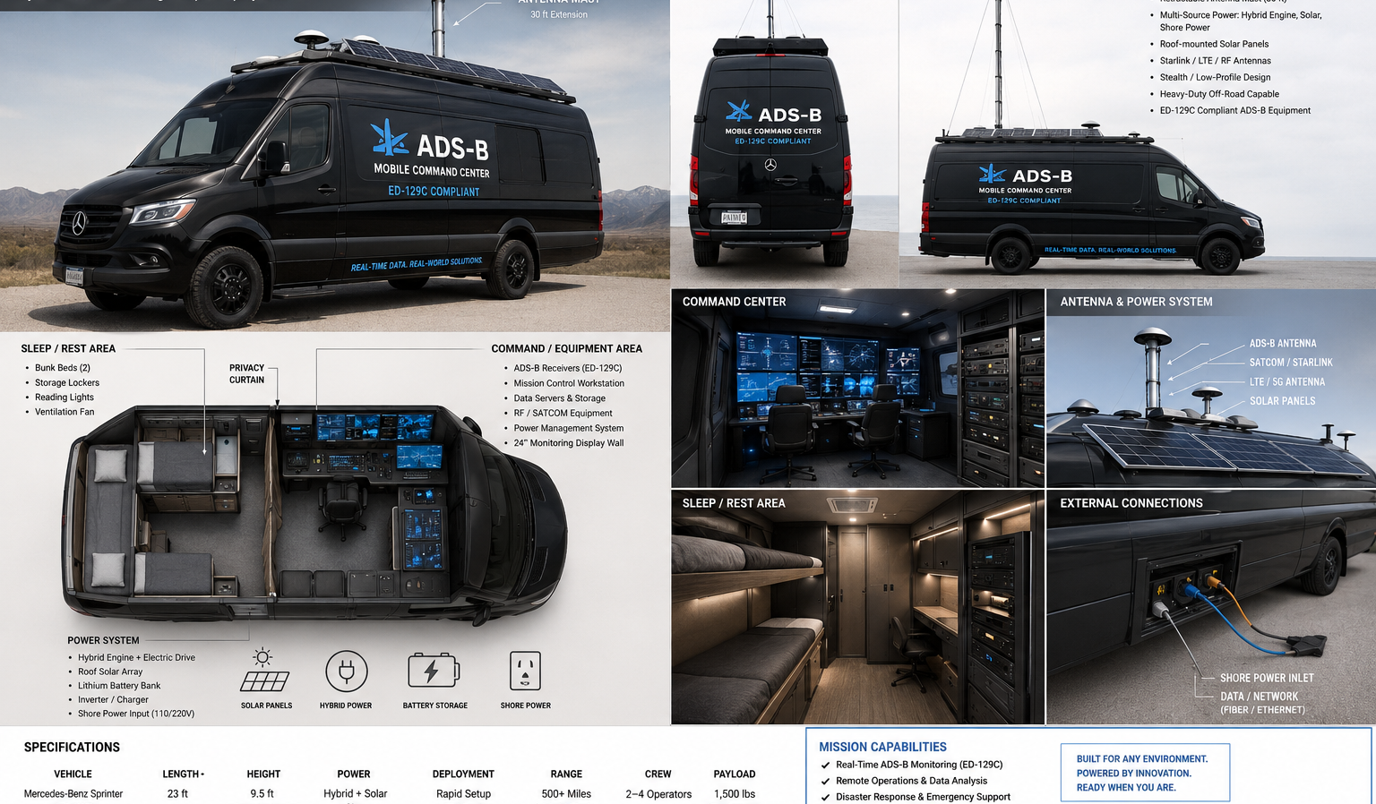
✈
ADSBMCC
Exterior platform concept
ADS-B MOBILE COMMAND CENTER
Two livery paths: high-visibility disaster-response white, or stealth/professional black for airport, defense, and infrastructure customers.
Solar roof array with MPPT charging
Blackout command-livery option
Retractable mast for better radio horizon
Integrated sleep/rest dorm zone
Satellite/cellular/LTE/5G backhaul options
Ruggedized equipment rack
Shore power + building data bulkhead
Onboard display wall and operator stations
Hybrid/gas/diesel resiliency for disaster deployments
Brandable as service fleet or agency asset
adsbmcc.com
05

Slide 6
✈
ADSBMCC
One-person deployable kit
ADS-B MOBILE COMMAND CENTER
A Pelican-style package expands the market: airport temporary events, remote sites, damaged towers, island response, or subcontracted surveillance support.
1
What rolls in
Rugged case, receiver/compute, lithium battery, solar controller, folding panels, tripod mast, antenna, cables, tablet display, and optional Starlink/cellular router.
2
How it deploys
Set tripod, connect antenna, point panels, power case, verify GNSS/time, start local display, establish VPN/backhaul, hand off feed or export local track archive.
3
Why it sells
Lower cost entry point, faster purchase cycle, rental-friendly, scalable fleet model, and usable as a redundancy node even when the van is not on-site.
adsbmcc.com
06

Slide 7
✈
ADSBMCC
Business model
ADS-B MOBILE COMMAND CENTER
Start as premium service + equipment rental, then expand into productized kits, fleet subscriptions, and recurring monitoring.
S
Deployment services
R
Rental / lease fleet
D
Data & support subscription
Day-rate or weekly incident support: operator, mobile van, kit, setup, reporting, and local command-post integration.
Van, mast trailer, and Pelican-case options for airports, emergency managers, utilities, remote construction, and government contractors.
Hosted dashboards, retention, alerting, uptime reporting, device management, software updates, and secure client data feeds.
45–65%
3
4
US / Caribbean
Target gross margin after build scale
Initial SKUs
Recurring revenue paths
Service geography
Phase 1: prototype van + rapid kit + demo deployments
Phase 2: formal system testing, SOPs, authority engagement, insurance, and procurement pathways
Phase 3: contract vehicles, managed fleet, and standardized regional partner nodes
adsbmcc.com
07

Slide 8
✈
ADSBMCC
Go-to-market wedge
ADS-B MOBILE COMMAND CENTER
Lead with disaster continuity and remote airspace awareness, then land aviation, infrastructure, and defense-adjacent accounts.
Airports with temporary tower, ramp, event, or outage needs
State/local emergency management and incident command teams
Wildfire, hurricane, flood, and island-response contractors
Energy, mining, border, port, and remote infrastructure operators
Aviation schools, airshows, and search-and-rescue organizations
→
Sales motion
$
Procurement packaging
Demonstration-first: show live aircraft track capture, coverage map, setup time, power autonomy, direct handoff, and after-action report.
Offer “managed deployment,” “agency-owned kit,” and “standby subscription” so clients can buy service before hardware.
adsbmcc.com
08

Slide 9
✈
ADSBMCC
Use of funds and milestones
ADS-B MOBILE COMMAND CENTER
Investor capital should de-risk certification posture, build repeatable hardware, and create credible field proof.
0–90 days
3–6 months
6–12 months
12–18 months
Finalize architecture, brand, vendor shortlist, SOPs, first case prototype
Build van demonstrator, RF testing, coverage modeling, insurance, demo videos
Pilot deployments, authority engagement, data feed hardening, client LOIs
Fleet unit #2, formal QA program, channel partners, recurring dashboard
∆
Primary spend categories
★
Milestone that unlocks valuation
Vehicle conversion, retractable mast, ADS-B receivers, timing/network gear, solar/lithium power, software dashboard, testing, legal/regulatory, insurance, and demonstration deployments.
A live pilot where ADSBMCC produces an operationally useful temporary coverage pocket, logs uptime and data integrity, and hands off a secure feed to a client command post.
adsbmcc.com
09

Slide 10
✈
ADSBMCC
Regulatory and operational guardrails
ADS-B MOBILE COMMAND CENTER
The winning strategy is to sell capability without overstating ATC authority.
Market as situational awareness, emergency support, testing, redundancy, and temporary surveillance support.
Do not represent the service as certified ATC separation unless formally approved by the relevant civil aviation authority.
Build toward ED-129C alignment for the 1090 MHz ES ground-system layer and document acceptance criteria early.
Engineer for auditability: GPS-disciplined time, system health logs, data quality checks, cybersecurity, and deployment records.
Coordinate spectrum, airport operations, safety, data sharing, insurance, privacy, and public-sector procurement requirements before live client service.
Source basis: FAA ADS-B program materials; EUROCAE ED-129C / ED-129C consultation scope; ICAO ADS-B workshop standards overview; EUROCONTROL ASTERIX CAT021 references.
adsbmcc.com
10

Slide 11
✈
ADSBMCC
ADS-B MOBILE COMMAND CENTER
Build the first field-proven mobile ADS-B command center brand.
ADSBMCC turns airspace surveillance into a deployable service: van, case, data, power, and operations under one brand.
PROTOTYPE
PILOT DEPLOYMENTS
FLEET SCALE
adsbmcc.com

